Slide 1
Degree Preserving Graph Summarization
By Jemish Variya and Raj Patel

Slide 2
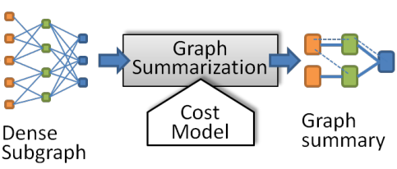
Graph Summarization
For a given graph G, find the summarized graph of G with supernodes as group of related nodes and superedges and group of related edges.
Makes graph easier to process, analyze and understand.
It includes,
Graph Summarization Model
Graph Reconstruction Scheme from summarized graph.

Slide 3
Objective
We may need to reconstruct the graph from its summarized graph. Existing Uniform reconstruction scheme performed well till the date, as there has been uniform degree skewed graphs were there.
Today this uniform reconstruction scheme seems to be failed to reconstruct graph while minimizing error and maintaining graph spectra, because today real world application graphs are inherently highly degree skewed. So we need to look for a model which incorporates a reconstruction scheme which don’t perturb graph spectra.

Slide 4
Summarization Methods
Following are the categories of graph summarization methods depending upon the purpose.
Error of Adjacency Matrix
Total Edge Number
Encoding Length

Slide 5
Reconstruction Scheme
Procedure to reconstruct the original graph from the summarized graph.
Most Important aspect of the Graph Summarization.
Many existing summarization model uses the Uniform Reconstruction scheme to reconstruct the graph.
But mostly real world graph database has highly degree skewed nodes.
That creates large differences between original graphs and reconstructed graphs in terms of degrees of nodes and other properties of graph.
That’s why DPGS is introduced.

Slide 6
DPGS
Degree-Preserving Graph Summarization.
Assigns superedges to proportional to node degrees in original graph.
Uses Minimum Description Length (MDL) to minimize the cost of summary Graph and Reconstruction Error.
It uses Locality Sensitive Hashing (LSH) to group candidate nodes and it merges nodes greedily within the groups.
More efficient yet effective than uniform reconstruction scheme in real world highly skewed Graphs.

Slide 7
DPGS Summarization
It uses MDL to create summary Graph with minimum error.
Mathematical formulation of Objective Function is given as:
L(M,D) = L(M) + L(D|M)
where, L(M) = Description Length of summary Graph
L(D|M) = Description Length of Errors.

Slide 8
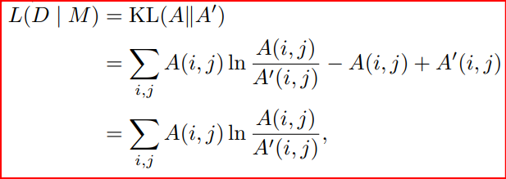
DPGS Summarization
To get the error between original & reconstructed adjacency matrix A & A’, we can use generalized KL - Divergence

Slide 9
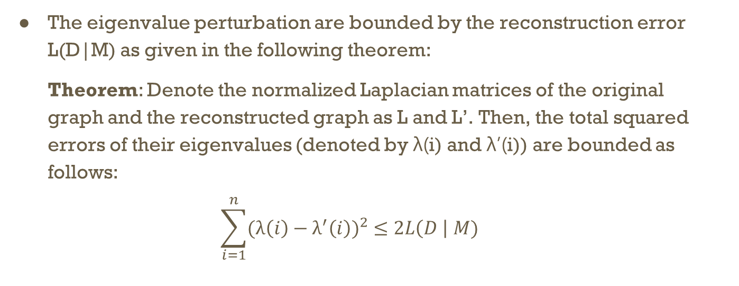
DPGS Summarization
The eigenvalue perturbation are bounded by the reconstruction error L(D|M) as given in the following theorem:
Theorem: Denote the normalized Laplacian matrices of the original graph and the reconstructed graph as L and L’. Then, the total squared errors of their eigenvalues (denoted by λ(i) and λ’(i)) are bounded as follows:
$$\sum_{i=1}^{n}{{(λ\left(i\right)−λ^{′}\left(i\right))}^{2} ≤2L\left(D \right| M)}$$

Slide 10
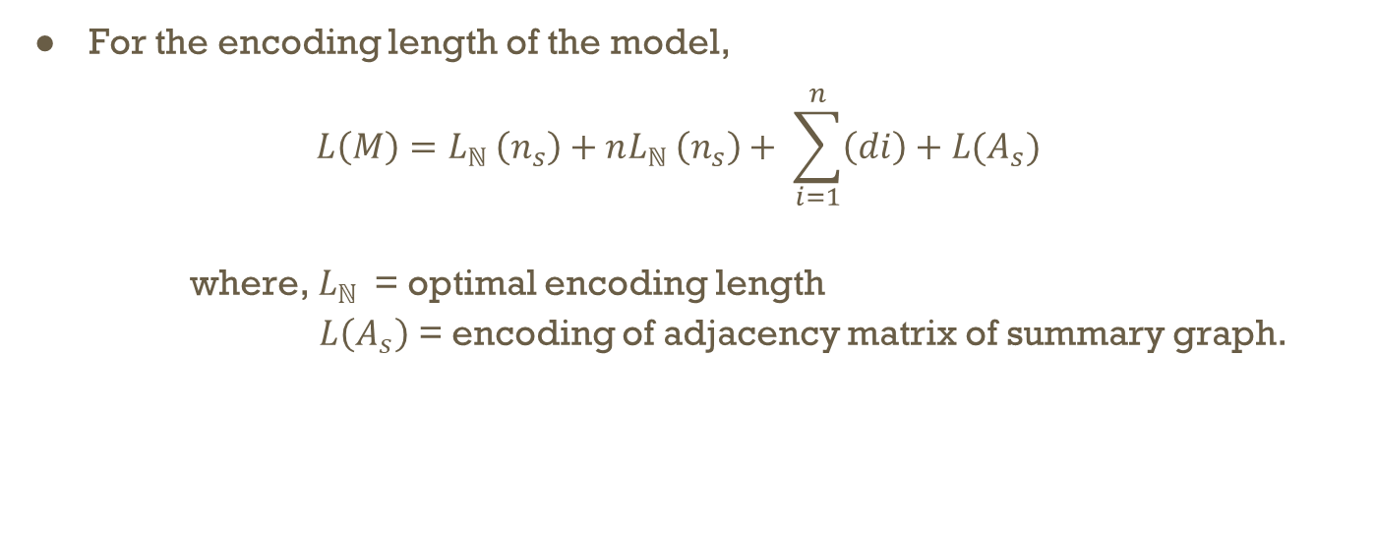
DPGS Summarization
For the encoding length of the model,
$$L\left(M\right)=L_{ℕ }\left(n_{s}\right)+nL_{ℕ }\left(n_{s}\right)+ \sum_{i=1}^{n}{\left(di\right)+L(A_{s})}$$
where, $L_{ℕ }$ = optimal encoding length
$L\left(A_{s}\right)$ = encoding of adjacency matrix of summary graph.

Slide 11
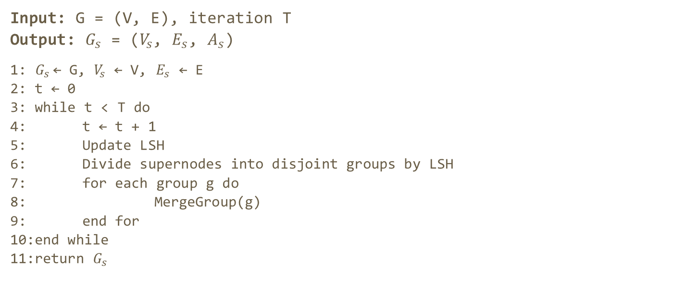
DPGS Algorithm
Input: G = (V, E), iteration T
Output: $G_{s}$ = ($V_{s}$, $E_{s}$, $A_{s}$)
1: $G_{s}$← G, $V_{s}$ ← V, $E_{s}$ ← E
2: t ← 0
3: while t < T do
4: t ← t + 1
5: Update LSH
6: Divide supernodes into disjoint groups by LSH
7: for each group g do
8: MergeGroup(g)
9: end for
10:end while
11:return $G_{s}$

Slide 12
Merge Group Algorithm
Input: g ⊂ VS
1: times ← log2|g|
2: nskip ← 0
3: while nskip < times and |g|≥ 1 do
4: pairs ← Sample log2 |g| node pairs from g
5: u, v ← arg max(i,j)∈pairs gain(i, j)
6: if gain(u, v) > 0 then
7: Merge u and v
8: nskip ← 0
9: else
10: nskip ← nskip + 1
11: end if
12: end while

Slide 13
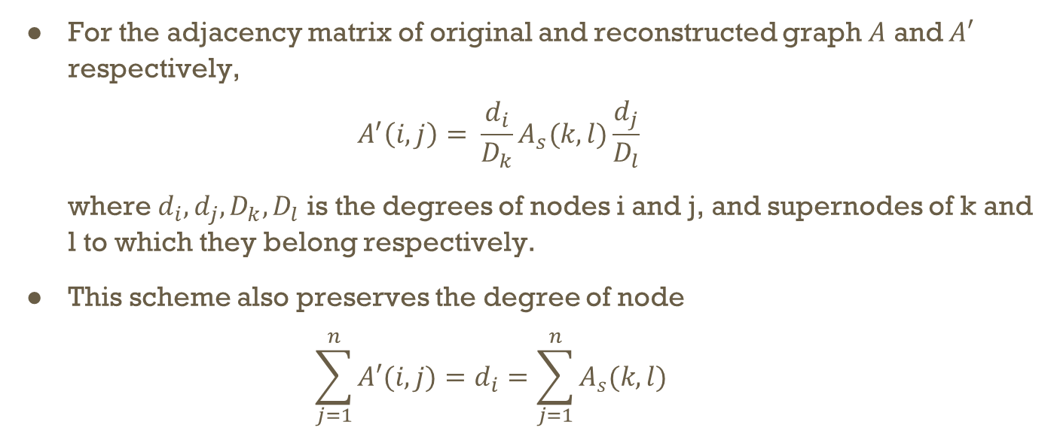
Configuration Based Reconstruction Scheme (CR Scheme)
For the adjacency matrix of original and reconstructed graph $A$ and $A′$ respectively,
$$A^{′}\left(i, j\right)= \frac{d_{i}}{D_{k}}A_{s}(k, l)\frac{d_{j}}{D_{l}}$$
where $d_{i},d_{j},D_{k},D_{l}$ is the degrees of nodes i and j, and supernodes of k and l to which they belong respectively.
This scheme also preserves the degree of node
$$\sum_{j=1}^{n}{A′(i, j)}=d_{i}=\sum_{j=1}^{n}{A_{s}(k, l)}$$

Slide 14
Advantages of DPGS
The time complexity of the algorithm is O(N*|E|).
This algorithm works efficiently in both Uniform and Highly Degree Skewed graphs.
This algorithm can reconstruct the original graph more efficiently and accurately than uniform reconstruction scheme, especially in Degree skewed graphs.
This algorithm can help to train a graph neural network efficiently, while preserving high accuracy in node classification task.

Slide 15
Experimental Analysis
Some experimental observations that demonstrates the milestones of DPGS.
Comparison of reconstruction schemes
In this experiment, some graph models like G(n,p) model with probability p = 0.02, and other graph models with power degree distribution with parameter α = 3.0, 3.5, 4.0.
In all the above models, CR scheme achieves lower reconstruction error than uniform reconstruction scheme. And the margin of improvement is very large when graphs are highly skewed.

Slide 16
Experimental Analysis
2. Effectiveness
In this experiment, DPGS is compared with SSumM and k-Gs algorithm on 8 real world datasets.
In that experiment DPGS does better summarization than other compared algorithms except flicker dataset in which result is marginal. But in other datasets, DPGS archives 28% improvement in terms of relative description length.

Slide 17
Experimental Analysis
3. Compatibility
In this experiment, Comparison is done between kGs and SSumM algorithm which follows uniform reconstruction scheme, and kGs(CR) and SSumM(CR) algorithm which are upgraded by CR scheme.
In the comparison in 3 different datasets, the upgraded algorithm with CR scheme gives more accurate results than their original algorithm based on uniform reconstruction scheme.

Slide 18
Experimental Analysis
4. Training GNNs on Summary Graphs
We can reduce the running time and required memory via graph summarization, without sacrificing the performance of GNNs much.
In this experiment, reddit and flicker datasets are used. And the result shows that this summarization model doesn’t harm the performance even when size of summary graph is 30% more.
5. Scalability
In this experiment, dataset of amazon is used and result shows that DPGS algorithm scales linearly with the number of edges.

Slide 19
Conclusion
DPGS algorithm is effective and efficient summarization algorithm which bounds perturbation of graph spectrum.
It gives better summary than several state-of-art methods.
It can be used to upgrade summarization models to improve their reconstruction accuracy.
It can be used in training of graph neural networks with less resources without compromising the performance.

